Slide 1

The New Normal – Philanthropy in a Pandemic
Chonée Dennis, President/CEO
Tracey Blodgett, Senior Consultant
September 2022

Slide 2

Chonée Dennis, CFRE
President/CEO of The Dennis Group Inc., a consultancy providing strategic and philanthropic guidance
Career highlights include senior positions in the health care, social service, and the environmental sectors
TDG was launched in 2000, offering guidance in all facets of fundraising, communications, government relations, governance, organizational change, re-engineering, volunteer management, crisis and project management, and redevelopment initiatives.
Specialize in capital campaigns – over 100
Notes:
Generalist
All sectors
ED, Consultant

Slide 3
Chonée Dennis, CFRE
Board Experience:
  Community Foundation of Greater Peterborough: Board Director / Governance Committee
  Lakefield College School: Trustee / Board Director / Finance / Capital Construction Committees.
  Niagara Community Foundation/AFP Golden Horseshoe: Founding Board Member
  Children’s Advocacy Centre of Niagara: Founding Board Member
Notes:
Generalist
All sectors
ED, Consultant

Slide 4

About Today’s Session
The past two and half years have had significant changes on how the world works, including how non-profit organizations approach fundraising.
In this session we will review how fundraising practices changed during the pandemic and the impact on philanthropy in the future.

Slide 5

My Learnings Are Informed By…
Client work
AFP International
Community Foundations of Canada
Imagine Canada
Canada Helps
Other resources

Slide 6
Donor Behaviour
Equity & Diversity
The New Normal
Operations
Communications

Slide 7
Donor Behaviour
The bad news…
4 out of 5 (80%) Canadians expect inflation and/or the prolonged impacts of the pandemic will negatively impact their financial situation
1 in 4 (25%) Canadians expect to use or are already using charitable services (2022). Up significantly from pre-covid.
1 in 4 (25%) Canadians expect to give less in 2022 than they did in 2021

Slide 8
Donor Behaviour
Steady decline in the number of Canadians that donate
Increased reliance on a smaller group of ageing donors
Most charities experienced overall decline in giving during pandemic. Essential pandemic non-profit service providers saw significant increases.
The giving gap is real and it’s significant.
TDG: Expected decline in small and mid-range giving to worsen due to inflation and increased interest rates

Slide 9
Donor Behaviour – Giving is Down

Slide 10
Donor Behaviour – Giving is Down

Slide 11
Giving Gap
“Giving gap somewhat eclipsed by larger giving and gifts by older donors”
Giving synchronized with stock market
Major and transformational gifts are up, from 2019

Slide 12
Donor Behaviour
Light at the end of the tunnel…
Family-owned Businesses: Emerging New Philanthropists
Increased awareness of the valuable role philanthropy can play in the community and within their families
  anchoring values
  aiding in the moral and leadership development of children
  shared purpose across generations and branches
Philanthropy seen as growing in important, core to business and client retention - intentional in their giving
Engaging independent philanthropic counsel or accessing numerous philanthropy offerings

Slide 13
Donor Behaviour
From Charitable Giving to Charitable Living
Alignment of values and priorities to make a difference
Traditional philanthropy supplemented with social finance initiatives and responsible investing of assets, social enterprise platforms, ethical consumerism, volunteerism and activism
Extending environmental, social and corporate governance and diversity, equity and inclusion commitments and practices
40% of next-gens moving to positions of control - the shift from charitable giving to charitable living will likely grow
Major and transformation gifts continue to grow
Gen X, millennials, Gen Y are giving!!!

Slide 14
Donor Behaviour
“Doing Good” Portfolio Approach
  Increasingly varied landscape of structures (and related governance) to support donor objectives:
    a private foundation
    donor advised fund
    combination of both for distinct purposes
  “Donor advised funds in Canada have grown from $4.4 billion in 2014 to a projected $6.5 billion in 2024. Non-profit initiatives and platforms that facilitate giving outside Canada add yet other dimensions.” - Canadianfamilyoffices.com

Slide 15
Diversity, Equity & Inclusion (DEI/JEDI)
In 2018, 1% of charities in Canada (representing many of the largest in the country) received 60% of all charitable donations
Community-based organizations that are led by or primarily serve BIPOC receive the lowest levels of giving and are chronically underfunded - and these organizations tend to be the ones on the ground addressing inequality through direct services or advocacy
Pandemic highlighted large societal gaps based on race, gender, disability and economic
Notes:
More donor support to these kinds of organizations is necessary, especially at this time when 56 per cent of charities in Canada are struggling and their COVID recovery is at risk.”

Slide 16
Diversity, Equity & Inclusion (DEI/JEDI)
Donors are responding with increased purpose and sense of urgency on the issue of inequality and the unequal impacts of climate change
Gen-X, Millennial and Gen-Y donors particularly concerned
Donor communities are more diverse as women, people of colour and new immigrants to Canada advance as wealth creators/holders and will have a growing, profound impact on how philanthropy is practiced and understood in Canada moving forward
Ignited calls for donors and foundations to give differently; less restrictive and more inclusive and collaborative.
Notes:
Point 3: The latter point will have a growing and profound impact on how philanthropy is practiced and understood in Canada moving forward.
Pandemic highlighted the large societal gaps based on race, gender, disability and economic
Acknowledged recognition on impact inequality has socially, economically or environmentally.
Pressure on Foundations and corporations to do better.
Business and corporations giving based on pressure from employees/shareholders
Private foundations and community foundations looking at increasing annual % of giving from 3% +++

Slide 17
Diversity, Equity & Inclusion (DEI/JEDI)
Collective of Quebec Foundations Against Inequality (including some of Canada’s largest foundations) recently launched a framework offering principles to guide donors to assess their “inequality footprint” to have greater impact through their work.

Slide 18
Operations
Not Business as Usual
56% of charities experiencing demand challenges, while 44% are meeting demand
60% anticipate demand for services will continue to increase
~33% anticipate organization will be stronger in terms of its ability to fulfill its mission
Some hard-hit charities are showing signs of cautious optimism; predict increased demand but expect slow recovery and capacity
Notes:
Imagine Canada Findings:
Some hard hit charities are showing signs of cautious optimism. Arts, culture & recreation organizations and organizations that rely on earned income have been among the hardest hit by the pandemic. Some of these organizations are now starting to predict increased demand.
Few charities are operating as usual, after two years of pandemic
Majority of charities are still operating with modifications or have temporarily suspended operations; 15% are operating as usual.
Demand for services continues to rise; > 40% reporting increased demand since the onset of the pandemic, up from about a third a year ago.
Three in five expect demand to increase in the next few months.
Capacity is not keeping pace with demand.
Only a quarter of organizations say their capacity to meet demand has increased and most don’t expect this situation to change in the near future. Impact of the pandemic is uneven.
60% charitable leaders predict that demand will increase over the next three to six months
20% anticipate this increase will be significant (see Figure 14).

Slide 19
Operations
Organizational Capacity
25% anticipate capacity to increase
20% anticipate their financial situation to worsen
25% say they cannot sustain operations for more than 12 months
31% expect both near-term demand and medium-term organizational capacity to be higher
7% predict increased demand combined with decreased capacity
For most non-profits capacity is not keeping pace with demand

Slide 20
Operations
Charities experiencing significant demand decreases, because operational disruption, are experiencing major challenges:
  82% have lost revenue and the average amount lost is -45.5%
  25% envision financial situation will worsen over the several months
  33% believe they cannot sustain operations for more than 12 months

Slide 21
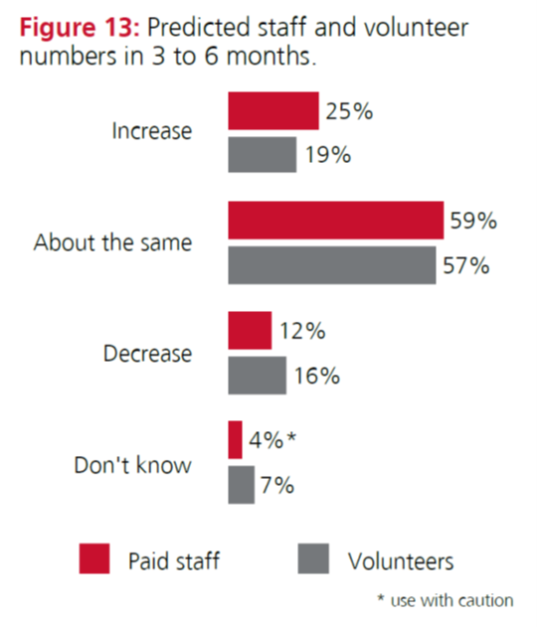
Operations – Human Resources
Staffing levels are expected to stay the same or increase
  59% stay the same
  25% see increase
  16% see decrease
50% have increased time and resources to mental health and well-being of staff and volunteers
Not seeing large increases in volunteers
Notes:
Addressing staff and volunteer mental health and well-being. Half of charities have increased the time and resources they devote to the mental health and well-being of their staff and volunteers but only a third have Employee Assistance Programs or similar supports.
Overall, leaders seem more optimistic about the paid staff situation than they were in late 2020 when 14% predicted paid staff layoffs and another 25% layoffs were a possibility if the conditions continued.
When it comes to volunteers, however, the proportion predicting an increase is only slightly larger than the proportion anticipating a decrease.

Slide 22
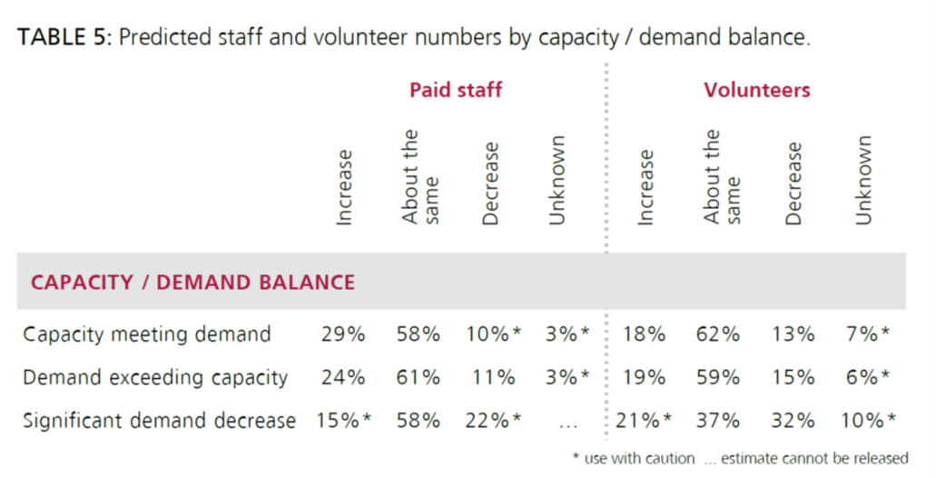
Operations – Size Matters!

Slide 23

Communications
Digital presence is crucial!
Website with online giving option
Social Media
Video tells the story
Video conferencing is here to stay for volunteer meetings and donor visits
Hybrid meetings and events
Notes:
My last point is Communications, because, this hasn’t changed – it is all about communications!
If you are not online, you are not visible.
You website needs to show who you are – user friendly and need to refresh/update frequently
Website is supported by social media – relate to your donors
…and video – tell stories about your organization and the people you serve
Video Conferencing will continue to play a role in daily operations/fundraising / campaigns
Impact on volunteers, organizations and donors.
Remote work – productivity
Reduced costs
Built in efficiencies for meetings that may increase participation.
On the flipside, conferencing tends to reduce human interactions, on-site tours

Slide 24
Campaigns: Keys to Success
Campaigns are successfully moving forward through the pandemic, many reaching and exceeding goal, by:
Focusing on the Mission: Organizations that are mission focused, experienced increased giving overall particularly from corporations, foundations and major donors
Knowing Their Donors: Adapt a strategy with a more sensitive approach to timing and consideration of financial implications

Slide 25
Campaigns: Keys to Success
Considering a Blended Campaign Model: capital, programming, operations
Focusing on Communications: Donors want to be kept informed - increase focus on outreach with a strong digital presence and other communication tools
Being Flexible: Online meetings allow leadership to have greater presence; online cultivation and stewardship will continue post-pandemic. Timelines need to constantly revisited too!
Remote Scope: ~ 60% being conducted remotely
Notes:
TDG’s campaigns ~ 60% being conducted through video conferencing

Slide 26
The Future of Philanthropy
Brace for a few more difficult years!
Donors are informed and more strategic givers than ever before – listen and take the time to develop personalized strategies.
Diversity, equity and inclusion as well as environmentally sustainable governance continue to be at the forefront.
Tell your story – what makes you unique?
Communicate, communicate, communicate!
Go digital! Your donors and volunteers are online – you should too!
Remote is here to stay!
Charities continue to serve a growing and invaluable role in our society - demand and capacity will continue to be a challenge!
Notes:
The future of philanthropy, while changed, also follows the principals pre-pandemic. Today, donors are more savvy, but in many cases are motivated differently – they want to see how they can make a difference. Take the time to listen to them and learn – develop a personalized strategy
Just like before the pandemic, tell your story! There are many different causes competing for donor interest – what makes your story unique? When you listen to your donors, you will learn the best way to tell a compelling story
If you haven’t moved to digital yet, what is stopping you? Your donors are online and your competing charities are on line – you need to be as well!
Communicate – your donors want to know how their donation has impacted – use the tools available to do so – your website and social media are great ways to stay connected. Layering your message will ensure you are heard and your donors feel valued.

Slide 27
Thank you
Thank you!
Questions?
cdennis@thedennisgroup.ca
705-201-1014
thedennisgroup.ca

Slide 28
Sources
https://imaginecanada.ca/sites/default/files/Sector-Monitor-The-uneven-impact-of-the-pandemic-on-Canadian-charities.pdf
https://canadianfamilyoffices.com/commentary/three-trends-that-will-influence-philanthropy-in-2022
https://www.canadahelps.org/en/the-giving-report/
Top Ten Risk Management Tips for Charities and NFP.pdf
ChangingTides_TheEvolutionOfGivingBehaviourInCanada_2022_Good_Works.pdf

